Slide 1
_retailer_ Briefing Book

Slide 2
REPORT OUTLINE
Section | Key Questions Answered | Metrics Covered
Channel Performance & Trends | What share of trips are commanded by the different retailer Channels and Outlets within the target channel? | Share of trips by Retailer channels and Outlets. Share shift from previous year.
 | How has the share changed from the past year?
Who is the shopper? | What are the Key Demographic characteristics of the shopper? | Gender, Age, Ethnicity, HH Income, Parental Identification, Employment Status, Device Ownership, Primary shopper.
 | What are the Key Attitude Segments and Kohorts the shoppers belong to? Which Attitude Statements do they identify most closely with? | shopper Attitude Segments. Top 2 Box Attitude Statements. Kohorts distribution.
 | What other establishments/channels are frequented by this retailer’s monthly+ shoppers? | Cross Frequency for channels and top retailers in each channel.
Path to Purchase and Trip Details | What is the Path to Purchase for trips to this retailer? What are the key characteristics of the trips? | Snapshot of P2P dashboard. Location Prior, Planning and Preparation, Trip Mission, Destination Items. Visit Motivations, Reasons for Store Choice Items Purchased, Impulse items, Expenditure, Checkout Method. Overall Satisfaction and Satisfaction with Different Attributes.

Slide 3
REPORT OUTLINE
Section | Key Questions Answered | Metrics Covered
Frequency Shares | How often do people visit this retailer? | Frequency distribution of shoppers within this retailer trade area, comparison with average of selected competitor set Frequency distribution of Yearly+ shoppers and Trips. Comparison with average of selected competitor set.
Strengths and Opportunities | What are the key shopper perceptions/ imageries about this retailer? Which are the strong attributes of this retailer and which can be improved? | Store Imageries for this establishment along with selected competitors. Strength and Weakness measured among competitors. Relative importance of different perceptions among frequent shoppers. Best in Class outlet for each imagery statement among competitors, Gap with this establishment
Beverage Section | What are the key Beverage Categories, Brands, Manufacturers and Ingredients consumed/purchased from this retailer? | Top Beverage Categories Top Beverage Brands Consumed among Key categories Beverage Consumption by Manufacturers Beverage Ingredients Purchased

Slide 4
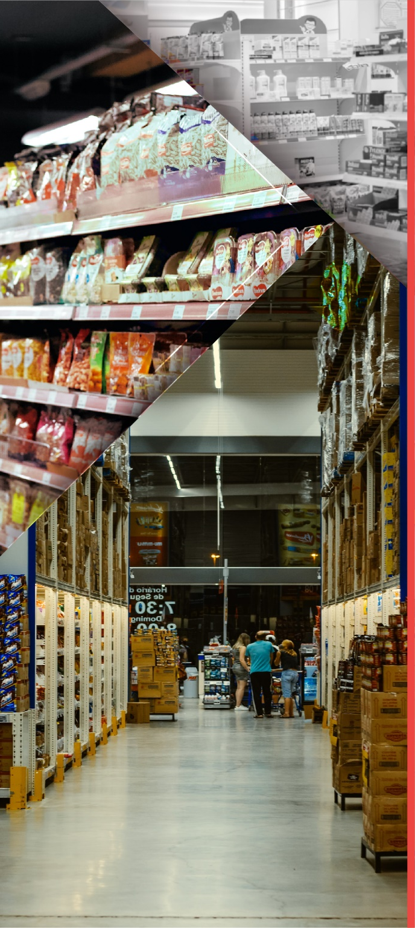


Channel Performance & Customer Trends
Retailer shopper Deep Dive
Who is the retailer shopper?
Path To Purchase and Trip Details
Frequency Shares
Strengths & Opportunities
Beverage Section

Slide 5
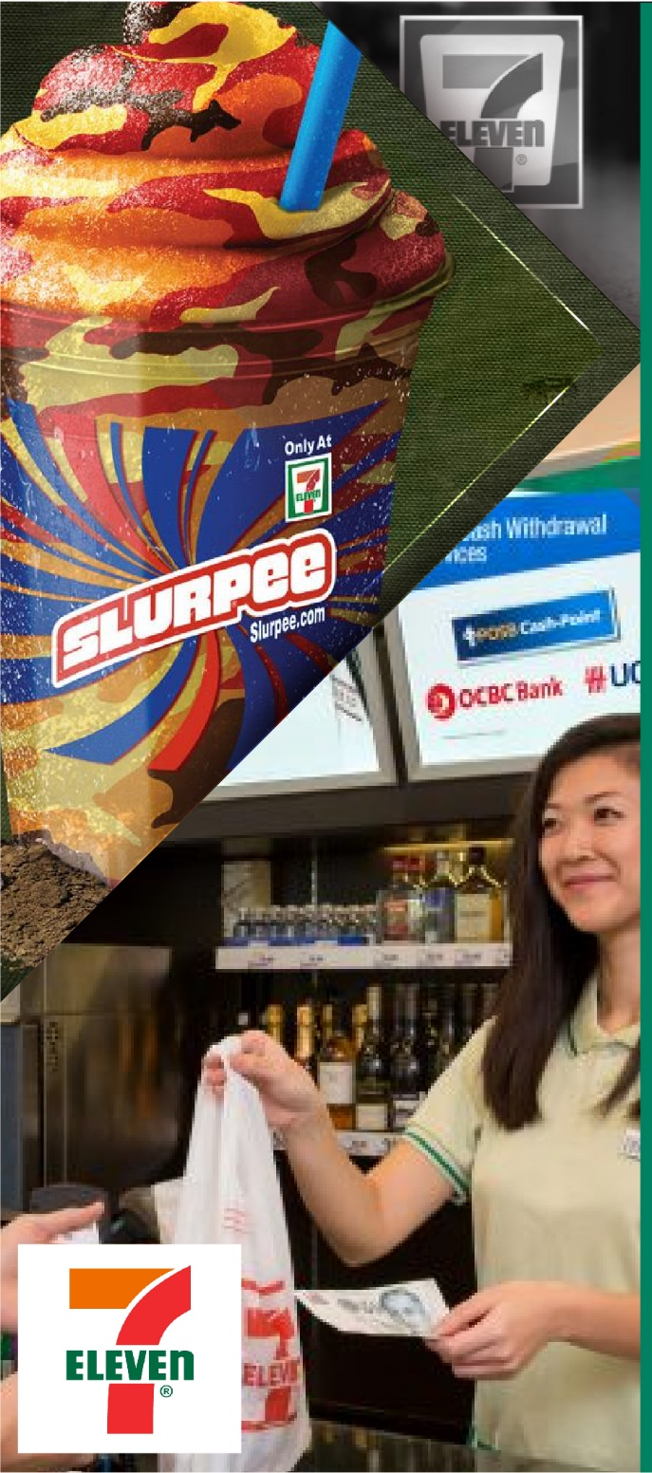
Channel Performance & Customer Trends
Retailer shopper Deep Dive
Who is the retailer shopper?
Path To Purchase and Trip Details
Frequency Shares
Strengths & Opportunities
Beverage Section

Slide 6


WHAT IS THE AVAILABLE SAMPLE SIZE ?
There are many lenses through which to dissect the _retailer_ shoppers and their trips, all with robust sample.
7 - Eleven
Monthly+ shoppers of _retailer_
Quarterly+ shoppers of _retailer_
Yearly+ shoppers of _retailer_
Visits
8,823
11,940
19,789
1,485
% of Convenience
41.9%
41.6%
49.9%
33.2%
Time Period: 12MMT Mar 2021 |

Slide 7


WHAT IS THE MARKET SHARE OF CHANNELS AND HOW DID IT SHIFT?
Notable Gains
GAINING
Supermarket/ Grocery
Share Change: _shareChange_
Visit Share: _visitChange_
LAGGING
Notable Loss
Club
Share Change: _shareChange_
Visit Share: _visitChange_
Indicates significant change at 95% confidence
Source: iShop | Base: Total Trips
Time Period: 12MMT Mar 2021 | Freq – Total Visits

Slide 8


WHAT ARE THE TOP RETAILERS IN THE CHANNEL?
Notable Gains
GAINING
LAGGING
Share Change: _shareChange_
Visit Share: _visitChange_
Notable Loss
Share Change: _shareChange_
Visit Share: _visitChange_
Indicates significant change at 95% confidence
Source: iShop
Time Period: 12MMT Mar 2021 | Freq – Total Visits
Notes:
Share of QSR

Slide 9
Channel Performance & Customer Trends
Retailer shopper Deep Dive
Who is the retailer’s shopper?
Path To Purchase and Trip Details
Frequency Shares
Strengths & Opportunities
Beverage Section

Slide 10






WHAT IS YOUR SHOPPERS DEMOGRAPHIC PROFILE?
Males – 50.3% of the visits to 7-Eleven are by Males
19-24 Yrs. – High for age group 19 -24yrs v Convenience
African American – Significantly High for AA
Males
Age Group
Index v
Convenience
Index v
Retail
Ethnicity
Index v Convenience
Index v
Retail
Index v Convenience | Index v Retail
93 | 101
14.6% | 13 – 18 yrs | 118 | 119
17.3% | 19 – 24 yrs | 129 | 118
23.6% | 25 – 34 yrs | 108 | 93
24.6% | 35 – 49 yrs | 92 | 96
15.6% | 50 – 64 yrs | 83 | 100
3.6% | 65 – 75 yrs | 55 | 57
55.0% | White | 98 | 105
20.6% | African American | 126 | 135
50.3%
18.2% | Hispanics | 92 | 83
4.1% | Asian | 76 | 47
HH Income – Visits to 7-Eleven are primarily made by shoppers with $25-75K HH Income
Students – Significantly High for
Student
Parent of child <18 yrs
Parent of child <18 yrs in HH
 | Index v Convenience | Index v Retail
Student | 124 | 122
Employed Full-Time | 102 | 96
Employed Part-Time | 106 | 96
Homemaker | 88 | 94
Retired | 76 | 94
White Collar | 109 | 98
Blue collar | 86 | 102
Employment Status
HH Income Under $25K
Index v Convenience | Index v Retail
106 | 125
20.0%
40.9%
24.4%
53.2%
22.3%
7-Eleven
11.2%
$75K+
4.6%
109 93
Convenience
86
93
Convenience
85
83
47.2%
Retail
6.5%
Retail
69.2%
19.1%
Note: Significantly high / Significantly low
Source: iShop
Time Period: 12MMT Mar 2021 | Freq – Total Visits
10

Slide 11





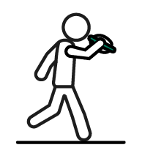
WHAT IS YOUR SHOPPERS SEGMENTATION?
shopper Segments
Pleasure shoppers
Quality
Comparers
Social shoppers
Price
Seekers
Payday shoppers
Errand Runners
23.6%
19.0%
16.8%
14.8%
13.7%
12.0%
Index v
Convenience
92 | 102 | 117 | 121 | 107 | 95
Index v
Retail
111 | 79 | 89 | 128 | 125 | 92
Primary shopper
Device Ownership
 | iPhone | Android Phone | iPad | Other Tablet | Amazon Echo/ Alexa | Google Home
7-Eleven | 51.8% | 52.8% | 36.7% | 34.7% | 32.5% | 10.6%
Index v Convenience | 111 | 87 | 113 | 95 | 116 | 98
Index v Retail | 116 | 90 | 120 | 100 | 125 | 120
Index v Convenience | Index v Retail
99 | 125
78.7%
Note: Significantly high / Significantly low
Source: iShop
Time Period: 12MMT Mar 2021 | Freq – Total Visits

Slide 12
WHAT ATTITUDE SEGMENT DEFINES YOUR SHOPPERS?
Top 2 Box Attitude Statements (Top 10)
Kohorts Distribution
7-Eleven | Index v Convenie--nce | Index v Retail
48.4% | 95 | 106
34.6% | 86 | 94
32.2% | 90 | 98
32.2% | 88 | 96
29.6% | 86 | 95
27.8% | 87 | 95
27.7% | 80 | 99
24.5% | 103 | 118
21.0% | 103 | 121
12.3% | 106 | 114
7-Eleven | Index v Convenie--nce | Index v Retail
32.0% | 253 | 332
19.6% | 62 | 68
12.7% | 207 | 405
12.6% | 74 | 89
12.1% | 180 | 327
5.6% | 36 | 44
5.4% | 54 | 77
Look For Grocery Coupons/Deals On Internet
Compare Prices Between Stores
Choose Based On Price, Coupons, Discounts
Fixed Budget For Grocery Shopping
Wait Until Payday To Stock Up
Go More Than One Store Get Best Deal
Use Snap/Wic Help Pay For Items
Prefer Buy Organic Or Natural Foods
Intent Purchase Healthy, Buy Unhealthy
Prefer Buy High-Quality Products
Survivors
Aspirers
Givers
Providers
Age Defiers
Change Makers
Seekers
Source: iShop
Time Period: 12MMT Mar 2021 | Freq – Total Visits

Slide 13















WHERE ELSE DO YOUR MONTHLY+ SHOPPERS FREQUENT?
TOP CHANNELS
Read as: 75.7% of Monthly+ 7-Eleven shoppers are also Monthly+ shoppers to Supermarket/Grocery
75.7%
100.0%
68.9%
57.4%
29.7%
Supermarket/ Grocery
Drug
Convenience
Dollar
Club
TOP 2 ESTABLISHMENTS
Read as:55.8% of 7-Eleven Monthly+ shoppers are also Monthly+ shoppers to Alberston’s
55.8%
23.1%
44.1%
9.8%
9.8%
Albertsons
Costco
Costco
Circle K
Costco
CVS
Dollar General
35.7%
21.2%
25.1%
8.6%
7.9%
Speedway
Walgreens
Sam’s Club
ALDI
Dollar Tree
Source: iShop
Time Period: 12MMT Mar 2021 | Freq – Total Visits

Slide 14
Channel Performance & Customer Trends
Retailer shopper Deep Dive
Who is the retailer shopper?
Path To Purchase and Trip Details
Frequency Shares
Strengths & Opportunities
Beverage Section

Slide 15



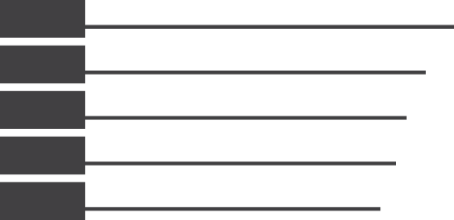











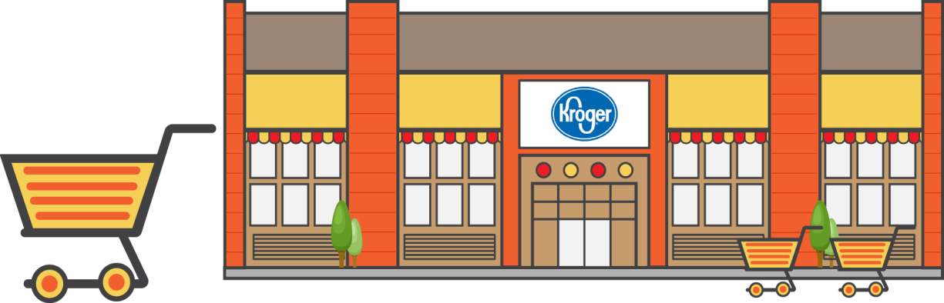
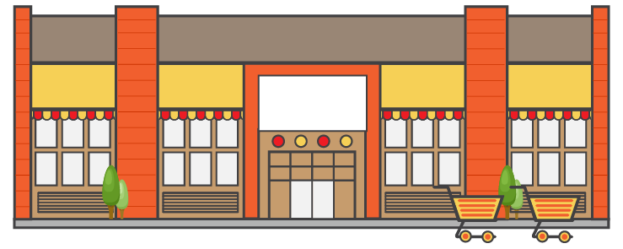






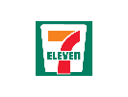
















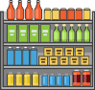





Path to Purchase | 7-ELEVEN|MAR 2019 12MMT
PRE-SHOP
PLANNING
TIME OF DAY
LOCATION PRIOR TO TRIP
-1.7
CONSIDERATION
WEEKDAY OR WEEKEND
36%
MORNING (6AM TO 11AM)
+3.1
37%
Planned
-1.5
+0.8
8%
Considered other stores
73%
Weekday
16%
+2.8
-0.1
-1.1
63%
Home
1%
Checked the pantry/refrigerator
MID-DAY (11AM TO 2PM)
15%
-3.2
-0.8
AFTERNOON (2PM TO 5PM)
27%
Weekend
21%
-1.1
EVENING (5PM TO 10PM)
12%
+2.2
WHO WITH
REASON FOR STORE CHOICE
NIGHT (10PM TO 6AM)
+3.9
+0.4
78%
Alone
75%
Get In and Out Quickly
TRIP MISSION
SHOP
GRAB AND GO
DESTINATION ITEM
PURCHASED NARTD
36%
+4.0
+3.6
BASKET SUMMARY
GRAB AND GO HOME
14%
Coffee
+4.6
TOP ITEMS
31%
+6.4
+0.5
63%
-13.5
14%
Carbonated Soft Drinks
22%
Gasoline/Diesel
FILL IN NON-FOOD
17%
-9.3
-11.4
13%
Gasoline/Diesel
-2.5
OTHER
IMMEDIATE CONSUMPTION
(Consumed Within 1 hour)
19%
Carbonated Soft Drinks
16%
-1.0
+3.8
76%
+6.9
18%
Coffee
POST-SHOP
IC Food/Bev in Basket
NUMBER OF ITEMS
1.9
Average Per Basket
-0.1
OVERALL SATISFACTION
SATISFACTION DRIVERS
LOCATION AFTER TRIP
+1.1
TIME SPENT
61%
Home
DOLLARS SPENT
-0.2
4 – 5 MIN
37%
+2.7
$8
91%
Satisfied (Top 2 Box)
Average Per Basket
Product
Selection
86%
Product
Pricing
79%
Service by
Employees
86%
Check-out
Experience
87%
Overall Store
Atmosphere
83%
Ease of
Shopping
92%
-1.4
+0.1
-0.9
-1.5
-1.6
-0.7
0.0
Source: CCNA iSHOP Tracker, Base - Total Trips, Sorted by: Largest Size, Time Period: MAR 2019 12MMT Filters: NONE
Sample Size – 1,587
* Stat tested at 95% CL against : CONVENIENCE, Filters: NONE
Classified - Confidential
15
Sample size in chart legend/label; Grey font = Low Sample (30-99)
Significantly Higher
Significantly Lower
15

Slide 16


HOW DO SHOPPERS PLAN THEIR VISITS?
Location Prior
Trip Mission
Planning
Home
Large Stock-Up
Grab and Go
Need It Now
Visit Was Somewhat Planned
38.8%
32.7%
29.8%
21.1%
Index v Convenience
103
Index v Convenience
107
Index v Convenience
92
Index v Convenience
121
Index v Convenience
90
41.4%
Index v Retail
98
Index v Retail
106
Index v Retail
85
Index v Retail
135
Index v Retail
92
Preparation Type
Top 3 Destination Items
Made A List
Searched For Coupons
Planned Specific Menu/Dish
Gasoline/
Diesel
Fresh Meat
Eggs
44.5%
20.5%
10.5%
44.5%
16.5%
15.4%
Index v Convenience
97
107
97
Index v Convenience
97
119
92
Index v Retail
106
86
101
Index v Retail
106
119
87
Note: Significantly high / Significantly low
Source: iShop
Time Period: 12MMT Mar 2021 | Freq – Total Visits
16

Slide 17








WHAT MOTIVATES YOUR SHOPPERS TO VISIT?
//
Reason For Store Choice Segment
Get a quick drink or snack
Take Advantage of Coupon/ Promo
Get In and Out Quickly
Buy Specific Items
Get The Best Everyday Value
78.5%
69.4%
51.5%
49.5%
33.3%
Index v Convenience
102
Index v Convenience
106
Index v Convenience
91
Index v Convenience
91
Index v Convenience
116
Index v Retail
101
Index v Retail
99
Index v Retail
82
Index v Retail
89
Index v Retail
115
Claimed Visit Motivations
Has Highest Quality Items
Most Convenient/ Time Saving
Has the best prices
Has hard to find items
Has Pharmacy/ Other Services
96.6%
94.1%
91.6%
89.0%
79.5%
Index v Convenience
102
Index v Convenience
106
Index v Convenience
103
Index v Convenience
106
Index v Convenience
109
Index v Retail
105
Index v Retail
106
Index v Retail
103
Index v Retail
101
Index v Retail
103
Note: Significantly high / Significantly low
Source: iShop
Time Period: 12MMT Mar 2021 | Freq – Total Visits

Slide 18

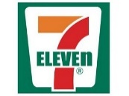
WHAT DIFFERENTIATES YOUR SHOPPERS SHOPPING CHOICES?
Items Purchased
Weekend/Weekday
Gasoline/ Diesel
Seafood
Fresh Meat
CSD
Hardware
Weekday
Weekend
Index v Convenience
Index v Convenience
Index v Convenience
Index v Convenience
Index v Convenience
81.9%
18.1%
175
85
85
127
2.5%
139
Index v Convenience
105
Index v Convenience
83
22.8%
42.1%
26.5%
6.1%
Index v Retail
Index v Retail
Index v Retail
Index v Retail
Index v Retail
178
94
75
161
86
Index v Retail
111
Index v Retail
69
Impulse Items
Gasoline/ Diesel
Seafood
Fresh Meat
CSD
Hardware
Smartphone/ Tablet influenced Purchase
Index v Convenience
Index v Convenience
Index v Convenience
Index v Convenience
Index v Convenience
17.9%
175
85
85
127
139
22.8%
Index v Retail
42.1%
Index v Retail
26.5%
Index v Retail
6.1%
Index v Retail
2.5%
Index v Retail
Index v Convenience
72
178
94
75
161
86
Index v Retail
85
Check-Out Method
Used Self-Checkout
Store Employee Rang Up Purchases
Average check size
Index v Convenience
86
Convenience - $7.44
25.3%
53.7%
Index v Convenience
185
$6.51
Index v Retail
66
Index v Retail
258
Retail - $8.33
Note: Significantly high / Significantly low
Source: iShop
Time Period: 12MMT Mar 2021 | Freq – Total Visits

Slide 19





HOW SATISFIED IS YOUR SHOPPER WITH THE VISIT?
Overall Satisfaction
Satisfaction Drivers (Top two)
Product Selection
97.2%
Product Pricing
88.1%
Very Satisfied
Index v Convenience
Index v Convenience
101
106
Index v Retail
Index v Retail
102
108
Service
94.1%
Checkout Experience
90.2%
79.5%
Index v Convenience
Index v Convenience
104
103
Index v Retail
Index v Retail
108
106
Index v Convenience
Atmosphere
83.7%
Ease of Shopping
87.5%
113
Index v Convenience
Index v Convenience
Index v Retail
117
107
100
Index v Retail
Index v Retail
103
106
Note: Significantly high / Significantly low
Source: iShop
Time Period: 12MMT Mar 2021 | Freq – Total Visits

Slide 20
Channel Performance & Customer Trends
Retailer shopper Deep Dive
Who is the retailer’s shopper?
Path To Purchase and Trip Details
Frequency Shares
Strengths & Opportunities
Beverage Section

Slide 21




HOW OFTEN DO THEY VISIT? – SHOPPERS FREQUENCY FUNNEL (TRADE AREA BASE)
\\
7-Eleven
Average Competitive Set
Conversion
Conversion
19.2%
15.5%
78.1%
72.1%
69.3%
60.9%
Competitive Set –
Source: iShop
Time Period: 12MMT Mar 2021 | Freq – Total Visits

Slide 22
HOW OFTEN DO THEY VISIT? (SHOPPER AND TRIP SHARE FOR 7-ELEVEN AND COMPETITOR SET)
\\
Note: Yearly+ Base for shopper Frequencies
Competitive Set –
Source: iShop
Time Period: 12MMT Mar 2021 | Freq – Total Visits

Slide 23
Channel Performance & Customer Trends
Retailer shopper Deep Dive
Who is the retailer’s shopper?
Path To Purchase and Trip Details
Frequency Shares
Strengths & Opportunities
Beverage Section

Slide 24





Strengths & Opportunities
versus

Slide 25
WHAT PERCEPTION DOES SHOPPERS HAVE OF YOUR BRAND?
\\
 | 7-Eleven | Alberstons | ALDI | Circle K | Costco | CVS | Sam’s Club
Has Good Coupon Policy | 6.6% | 5.6% | 5.0% | 4.0% | 4.4% | 8.4% | 6.5%
Has Good Fuel Prices | 23.6% | 55.1% | 43.1% | 59.2% | 53.8% | 61.0% | 1.4%
Has Good Sales | 11.4% | 8.0% | 7.2% | 9.1% | 7.7% | 10.8% | 54.0%
Has Low Everyday Prices | 13.7% | 11.7% | 9.0% | 16.7% | 9.7% | 11.2% | 74.4%
Provides Good Overall Value | 19.9% | 25.2% | 17.6% | 33.2% | 21.7% | 24.2% | 76.1%
Carries High-Quality Products | 14.4% | 21.8% | 11.6% | 25.1% | 18.1% | 16.5% | 45.7%
Has Good Selection | 20.3% | 24.1% | 16.9% | 29.1% | 19.9% | 17.4% | 49.4%
Offers Unique Appealing Products | 12.5% | 19.4% | 8.3% | 17.7% | 12.6% | 9.6% | 51.3%
Rarely Runs Out Of Stock | 20.5% | 28.8% | 16.1% | 32.1% | 17.1% | 17.4% | 28.5%
Has Clean Shopping Area | 29.8% | 48.2% | 29.2% | 54.1% | 38.1% | 35.6% | 63.5%
Has A Pharmacy I Trust | 2.6% | 3.0% | 2.1% | 1.0% | 0.7% | 1.1% | 1.2%
Has Clean Restrooms | 10.6% | 37.9% | 15.7% | 50.0% | 31.4% | 22.3% | 28.6%
Has Good, Safe Parking Facilities | 27.3% | 52.5% | 29.7% | 50.7% | 36.4% | 37.0% | 68.5%
Is A Store I Trust | 30.7% | 51.5% | 27.3% | 48.8% | 31.5% | 36.8% | 67.1%
Is Family-Friendly | 25.5% | 45.1% | 26.2% | 40.2% | 30.9% | 28.8% | 57.9%
Has Friendly, Comfortable Atmosphere | 23.3% | 50.2% | 23.1% | 46.6% | 29.0% | 28.5% | 52.9%
Is A Fun Place To Shop | 15.1% | 15.2% | 8.8% | 24.3% | 12.6% | 12.0% | 38.8%
Has A Familiar Layout | 35.5% | 48.6% | 30.7% | 47.7% | 35.3% | 36.8% | 61.3%
Has Easy, Quick Checkout Experience | 38.2% | 44.7% | 34.5% | 53.7% | 38.9% | 37.4% | 45.1%
Has Convenient Hours | 55.0% | 57.0% | 49.0% | 64.6% | 51.5% | 55.0% | 44.4%
Has Items Frequently Buy In Convenient Location | 32.7% | 41.5% | 30.5% | 42.7% | 29.1% | 32.8% | 54.7%
Good Place To Grab Quick Meal, Beverage, Snack | 59.6% | 73.0% | 51.3% | 71.1% | 55.0% | 59.9% | 10.9%
Is Conveniently Located | 51.5% | 61.5% | 50.2% | 57.0% | 44.4% | 52.0% | 64.2%
Is Easy To Get In And Out Of Quickly | 52.3% | 62.8% | 49.3% | 62.9% | 51.9% | 53.9% | 49.8%
Is Well-Organised/Easy To Shop | 32.2% | 39.8% | 28.5% | 45.9% | 35.1% | 32.1% | 61.1%
Offers One-Stop Shopping | 14.5% | 13.2% | 12.2% | 15.8% | 8.3% | 12.1% | 24.9%
Has Good Loyalty Program | 16.7% | 10.7% | 11.9% | 11.2% | 16.2% | 50.5% | 2.3%
Has Good Customer Service Policies | 8.9% | 11.8% | 6.2% | 11.8% | 5.5% | 6.8% | 32.7%
Has Helpful, Courteous, Knowledgeable Employees | 19.2% | 35.8% | 17.7% | 41.7% | 22.3% | 25.7% | 42.8%
Has Product Demonstrations/Product Samples | 4.7% | 5.2% | 2.6% | 3.9% | 2.5% | 2.6% | 3.8%
None Of These | 11.9% | 6.0% | 13.7% | 6.9% | 12.2% | 6.2% | 3.8%
Note: Strength >3% / Weakness -3%
Source: iShop
Time Period: 12MMT Mar 2021 | Freq – STORE IN TRADE AREA

Slide 26
WHAT ARE THE PERCEPTUAL STRENGTH & OPPORTUNITIES OF YOUR OUTLET?
\\
 | 7-Eleven | Alberston’s | ALDI | Circle K | Costco | CVS | Sam’s Club
Has Good Coupon Policy | 6.5% | -3.4% | 6.7% | -7.0% | 2.9% | 5.0% | -10.6%
Has Good Fuel Prices | -13.2% | 9.5% | 8.1% | 11.5% | 15.6% | 20.9% | -52.4%
Has Good Sales | 1.6% | -10.7% | -0.8% | -11.6% | -3.5% | -2.3% | 27.2%
Has Low Everyday Prices | -1.5% | -12.4% | -4.5% | -9.5% | -7.0% | -7.3% | 42.1%
Provides Good Overall Value | -5.6% | -9.1% | -6.1% | -3.2% | -5.2% | -4.5% | 33.7%
Carries High-Quality Products | -1.8% | -3.3% | -2.8% | -2.0% | 0.5% | -3.0% | 12.5%
Has Good Selection | 0.7% | -4.3% | -1.0% | -1.5% | -1.1% | -5.5% | 12.7%
Offers Unique Appealing Products | -0.6% | -2.6% | -3.1% | -6.3% | -1.9% | -6.8% | 21.2%
Rarely Runs Out Of Stock | 3.3% | 2.7% | 0.6% | 3.9% | -1.5% | -3.1% | -5.8%
Has Clean Shopping Area | -7.2% | 2.4% | -6.0% | 6.2% | -0.3% | -4.7% | 9.5%
Has A Pharmacy I Trust | 6.5% | -1.9% | 7.9% | -5.9% | 3.3% | 1.8% | -11.8%
Has Clean Restrooms | -11.8% | 6.7% | -4.9% | 16.7% | 7.6% | -3.4% | -10.8%
Has Good, Safe Parking Facilities | -10.2% | 6.2% | -6.0% | 2.3% | -2.4% | -3.8% | 14.0%
Is A Store I Trust | -5.6% | 6.3% | -7.2% | 1.6% | -6.2% | -2.7% | 13.8%
Is Family-Friendly | -5.2% | 5.6% | -2.7% | -1.4% | -1.2% | -5.2% | 10.2%
Has Friendly, Comfortable Atmosphere | -7.3% | 10.8% | -5.7% | 5.1% | -3.0% | -5.4% | 5.4%
Is A Fun Place To Shop | 2.6% | -6.1% | -1.9% | 0.9% | -1.2% | -3.7% | 9.4%
Has A Familiar Layout | -1.1% | 3.1% | -4.1% | 0.2% | -2.7% | -3.1% | 7.7%
Has Easy, Quick Checkout Experience | 2.1% | -0.2% | 0.2% | 6.6% | 1.4% | -2.0% | -8.1%
Has Convenient Hours | 6.9% | 0.0% | 2.7% | 5.6% | 2.0% | 3.6% | -20.7%
Has Items Frequently Buy In Convenient Location | 0.7% | 0.6% | 0.3% | -0.2% | -4.4% | -2.5% | 5.6%
Good Place To Grab Quick Meal, Beverage, Snack | 10.9% | 15.4% | 4.3% | 11.5% | 4.9% | 7.9% | -54.9%
Is Conveniently Located | 2.8% | 3.9% | 3.2% | -2.7% | -5.7% | 0.0% | -1.6%
Is Easy To Get In And Out Of Quickly | 3.3% | 4.9% | 2.1% | 3.0% | 1.4% | 1.5% | -16.2%
Is Well-Organised/Easy To Shop | -1.4% | -2.6% | -3.3% | 1.4% | 0.1% | -4.7% | 10.5%
Offers One-Stop Shopping | 5.7% | -4.4% | 5.2% | -3.8% | -1.9% | 0.1% | -0.9%
Has Good Loyalty Program | 5.3% | -9.6% | 2.3% | -11.1% | 3.4% | 35.8% | -26.1%
Has Good Customer Service Policies | 2.6% | -3.4% | 1.7% | -5.4% | -2.2% | -2.8% | 9.4%
Has Helpful, Courteous, Knowledgeable Employees | -4.4% | 3.3% | -4.1% | 7.1% | -2.8% | -1.2% | 2.2%
Has Product Demonstrations/Product Samples | 6.8% | -1.6% | 6.4% | -5.0% | 3.2% | 1.3% | -11.1%
None Of These | 8.9% | -5.8% | 12.4% | -7.0% | 7.8% | -0.1% | -16.2%
Note: Strength >3% / Weakness -3%
Source: iShop
Time Period: 12MMT Mar 2021 | Freq – STORE IN TRADE AREA

Slide 27
WHAT PERCEPTIONS ARE MOST IMPORTANT TO REGULAR (MONTHLY+) SHOPPERS OF THE COMPETITIVE SET?
Average Imagery Difference – Monthly+ shoppers vs. Total Market (Trade Area)
Has Good Coupon Policy | 189
Has Good Fuel Prices | 182
Has Good Sales | 179
Has Low Everyday Prices | 173
Provides Good Overall Value | 168
Carries High-Quality Products | 163
Has Good Selection | 158
Offers Unique Appealing Products | 153
Rarely Runs Out Of Stock | 148
Has Clean Shopping Area | 143
Has A Pharmacy I Trust | 138
Has Clean Restrooms | 133
Has Good, Safe Parking Facilities | 128
Is A Store I Trust | 123
Is Family-Friendly | 118
Has Friendly, Comfortable Atmosphere | 113
Is A Fun Place To Shop | 108
Has A Familiar Layout | 103
Has Easy, Quick Checkout Experience | 98
Has Convenient Hours | 93
Has Items Frequently Buy In Convenient Location | 88
Good Place To Grab Quick Meal, Beverage, Snack | 83
Is Conveniently Located | 78
Is Easy To Get In And Out Of Quickly | 73
Is Well-Organised/Easy To Shop | 68
Offers One-Stop Shopping | 63
Has Good Loyalty Program | 58
Has Good Customer Service Policies | 53
Has Helpful, Courteous, Knowledgeable Employees | 48
Has Product Demonstrations/Product Samples | 43
Relatively Higher Among Monthly+ shoppers
Relatively Lower Among Monthly+ shoppers
Time Period: 12MMT Mar 2021 | Freq – STORE IN TRADE AREA

Slide 28
COMBINING ‘FAIR SHARE’ PERFORMANCE WITH ‘IMAGERY LIFT’ IMPORTANCE HELPS US FOCUS ON KEY OPPORTUNITIES
More Important And Week Performance
Improve
More Important And Strong Performance
Protect
Relative Lift in Ratings among Monthly+ Dining across Competitive Set
Less Important And Week Performance
Ignore
Less Important And Strong Performance
Protect
Establishment Imagery Fair Share Weaknesses/Strengths
Source: iShop
Time Period: 12MMT Mar 2021 | Freq – Total Visits

Slide 29
Channel Performance & Customer Trends
Retailer shopper Deep Dive
Who is the retailer’s shopper?
Path To Purchase and Trip Details
Frequency Shares
Strengths & Opportunities
Beverage Section

Slide 30
Beverage Section

Slide 31
WHAT ARE THE KEY BEVERAGE CATEGORIES PURCHASED?
Top In-Store Beverage Categories and Their YOY Change
Note: Significantly high / Significantly low
Source: iShop
Time Period: 12MMT Mar 2021 | Freq – Total Visits

Slide 32










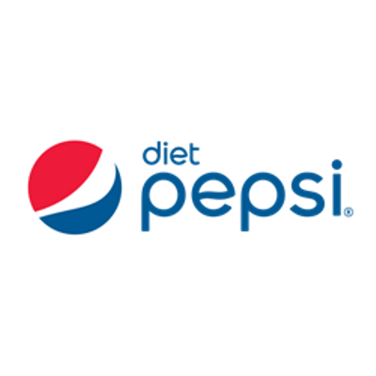


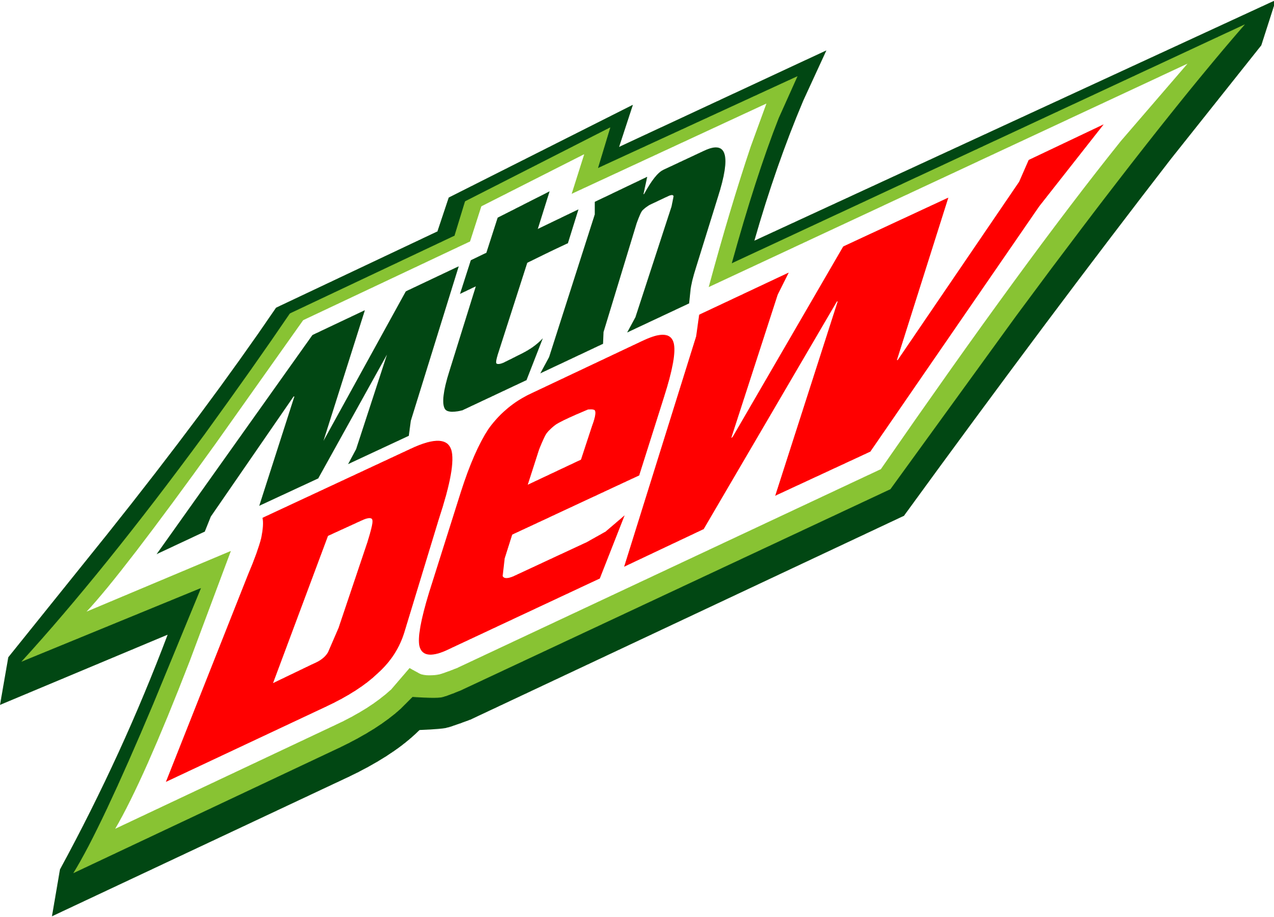

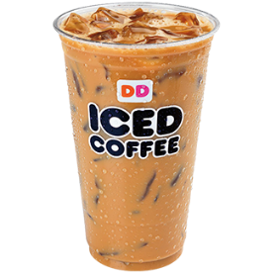

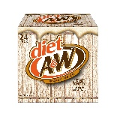

WHAT ARE THE TOP BEVERAGE BRANDS AMONG THE KEY CATEGORIES?
Top In-Store Beverage Brands for 7-Eleven
SSD Regular
SSD Diet
RTD Coffee
Brands |  | Index V. Convenience | Index V. Retail
 | 4.9% | 95 | 106
 | 2.2% | 86 | 94
 | 1.8% | 90 | 98
 | 1.3% | 88 | 96
 | 1.1% | 86 | 95
Brands |  | Index V. Convenience | Index V. Retail
 | 1.0% | 95 | 106
 | 0.8% | 86 | 94
 | 0.6% | 90 | 98
 | 0.3% | 88 | 96
 | 0.2% | 86 | 95
Brands |  | Index V. Convenience | Index V. Retail
 | 1.0% | 95 | 106
 | 0.8% | 86 | 94
 | 0.6% | 90 | 98
 | 0.3% | 88 | 96
 | 0.2% | 86 | 95
Note: Significantly high / Significantly low
Source: iShop
Time Period: 12MMT Mar 2021 | Freq – Total Visits

Slide 33
HOW DO THE KEY BEVERAGE MANUFACTURERS PERFORM?
Top In-Store Manufactures Net for 7-Eleven
Note: Significantly high / Significantly low
Source: iShop
Time Period: 12MMT Mar 2021 | Freq – Total Visits

Slide 34
WHAT ARE THE KEY BEVERAGE INGREDIENTS PURCHASED?
Top In-Store Beverage Ingredients for 7-Eleven
Note: Significantly high / Significantly low
Source: iShop
Time Period: 12MMT Mar 2021 | Freq – Total Visits

Slide 35
Thank You!

Slide 36
Appendix
(Best in Class Comparison for Imageries)

Slide 37


IMAGERY SNAPSHOT: 7-ELEVEN VS COMPETITION – ESTABLISHMENT IN TRADE AREA
Best-In-Class
Establishment
Rating
Products
46.9%
39.0%
38.6%
26.4%
26.4%
52.0%
46.9%
41.2%
Convenience
40.0%
36.8%
31.4%
30.4%
16.7%
16.7%
Source: iShop
Time Period: 12MMT Mar 2019

Slide 38
IMAGERY SNAPSHOT: 7-ELEVEN VS COMPETITION - ESTABLISHMENT IN TRADE AREA
Best-In-Class
Establishment
Rating
59.9%
Atmosphere
58.4%
26.3%
45.5%
42.1%
40.9%
Value
63.9%
22.4%
57.0%
Service
44.3%
24.7%
Other
44.5%
16.7%
Source: iShop
Time Period: 12MMT Mar 2019

